Slide 1

Artificial Intelligent introduction
Presenter

Slide 2
Agenda
Introduction
Aspects of AI
Problems
How to start?
What things you need to prepare?
Reference

Slide 3
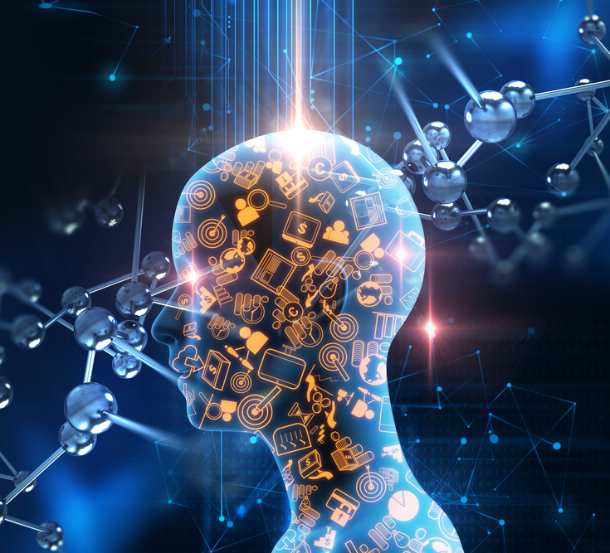
Introduction
Notes:
AI = Artificial Intelligent

Slide 4
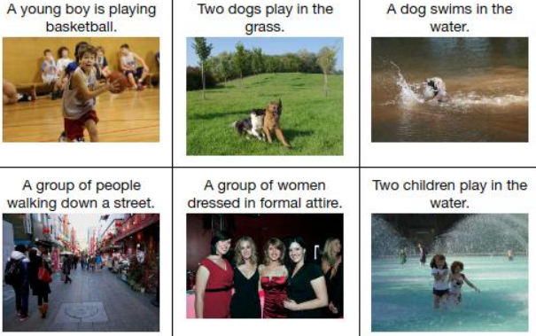
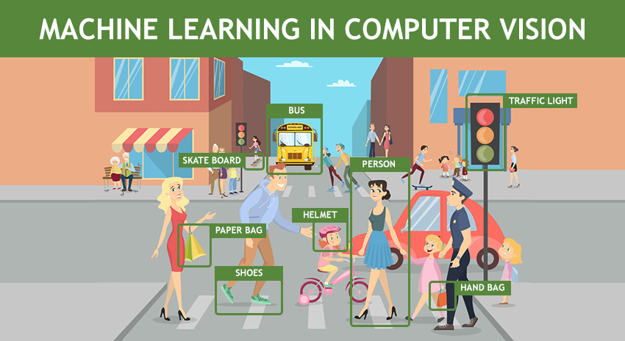
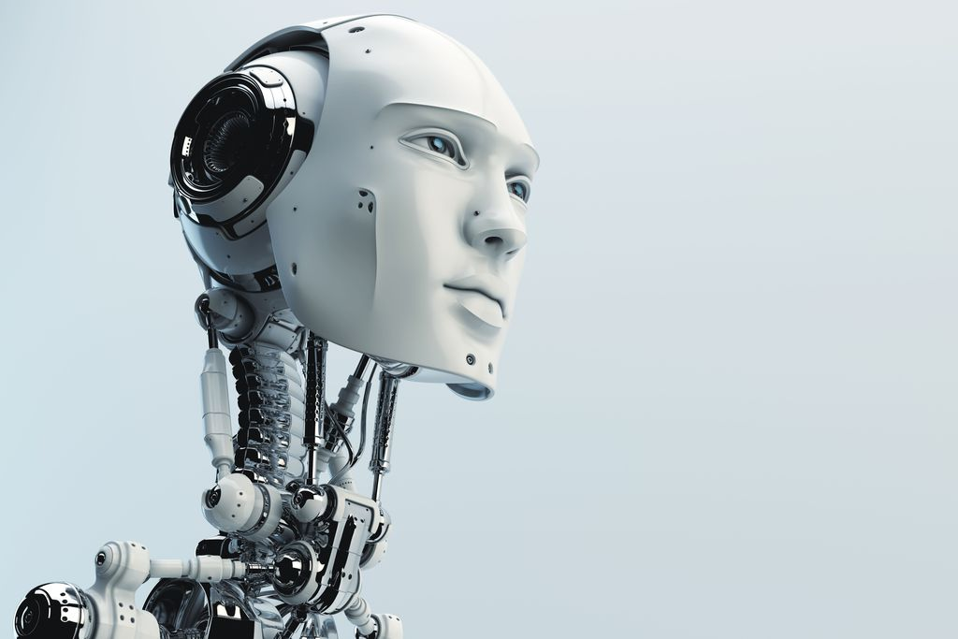
Introduction
- Machine thinking, acting like human => A.I
Computer vision
Automatic image captioning

Slide 5
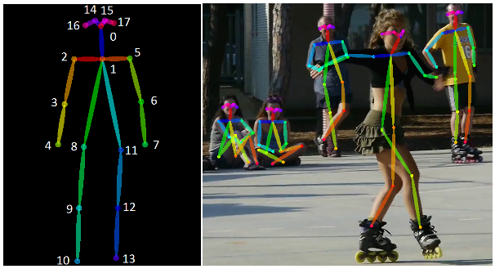
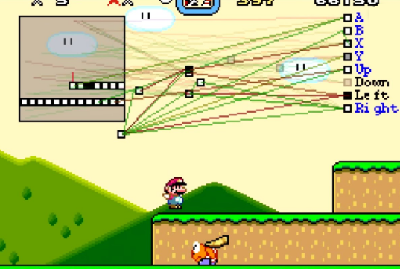
Introduction
Pose estimation
Learn playing game

Slide 6
Aspects of AI
Notes:
AI = Artificial Intelligent

Slide 7
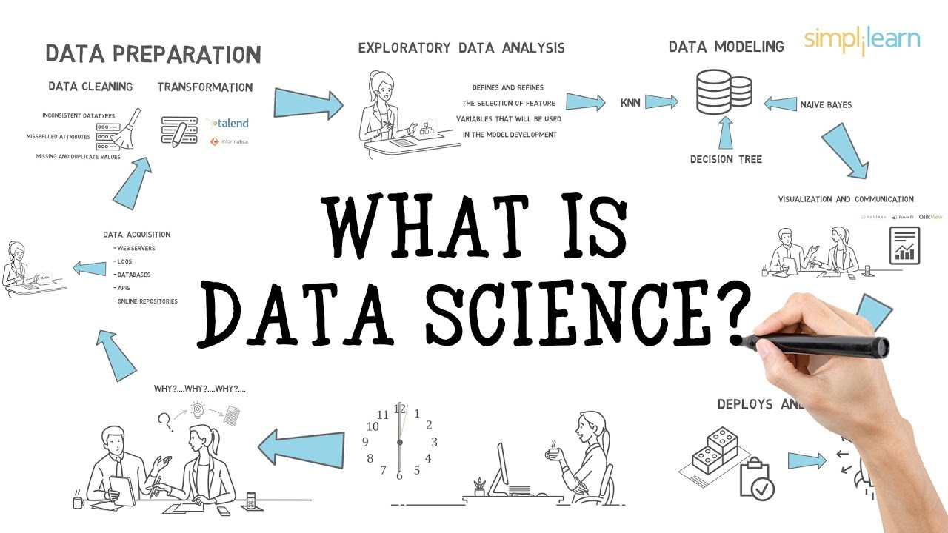
Aspects of AI
1. Data science
BIG DATA!
How can we exploit useful data from the big data?! ☺
Key word: Data mining

Slide 8
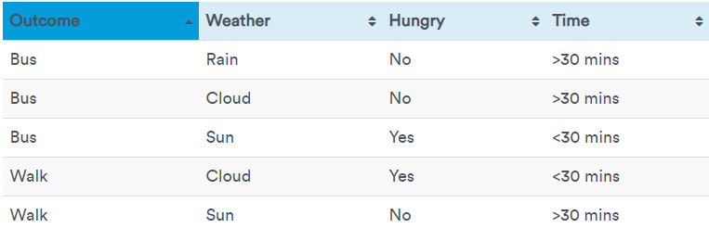
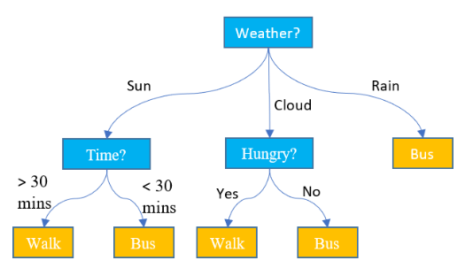
Aspects of AI
…
Suppose that we have a table with data about deciding walk or take a bus base on some taken conditions. From the table we can find the rules. That is the data mining!
PS: Just an example ☺, the data maybe uncorrect!

Slide 9
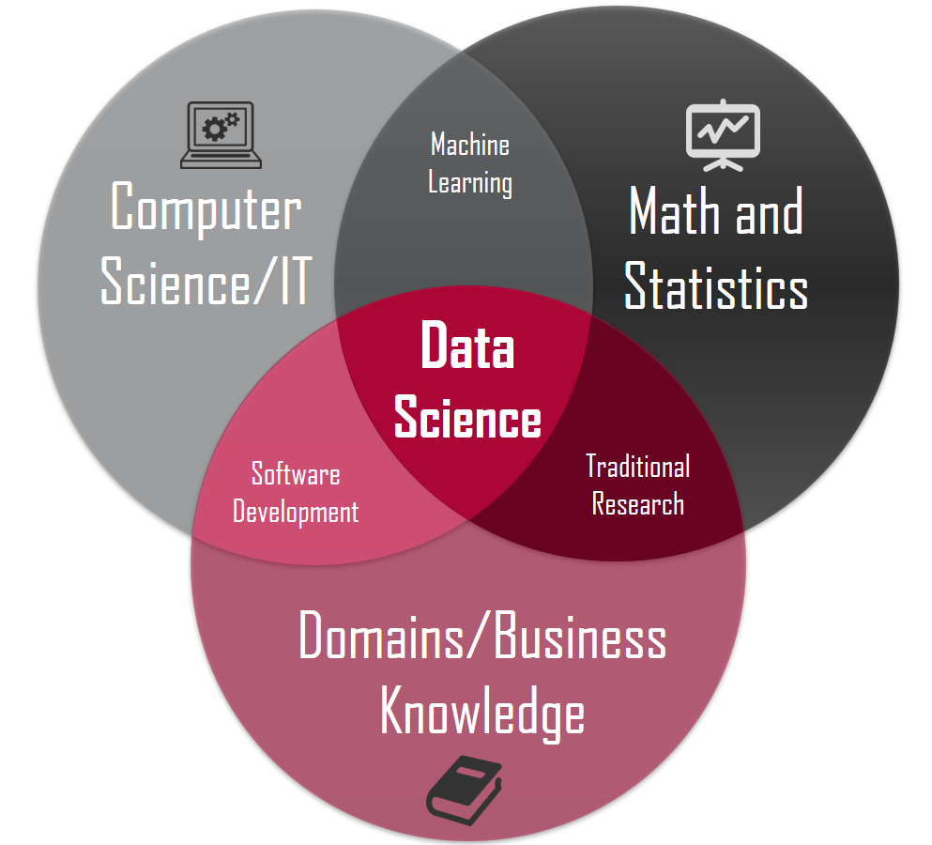
Aspects of AI
1. Data science
Data science is a collection of 3 main things.
It so difficult if you don’t have basic knowledge about Math and Statistics. But you can start with Data analysis!

Slide 10
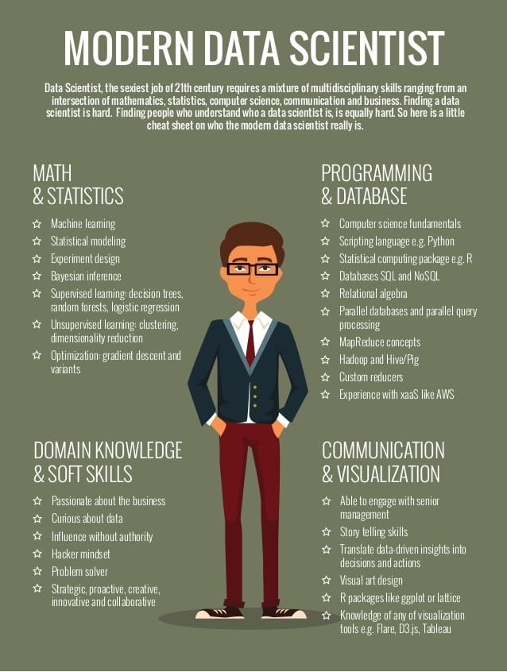
Aspects of AI
1. Data science
If you want to a good data science engineer, you can refer beside image! ☺

Slide 11

Aspects of AI
2. Computer vision
Computer Vision is a field of deep learning that enables machines to see, identify and process images like humans.

Slide 12
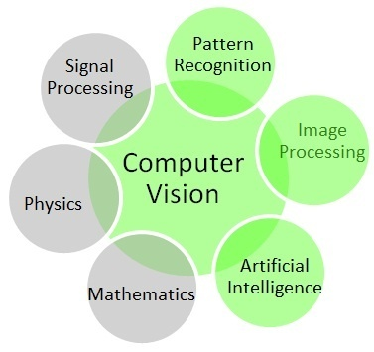
Aspects of AI
1. Computer vision

Slide 13
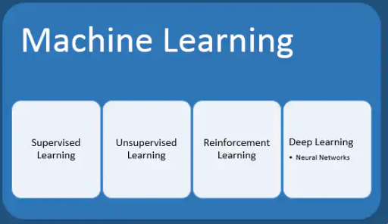
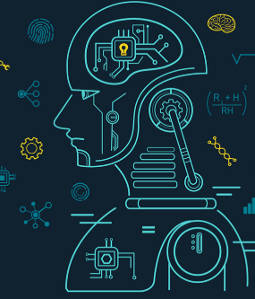
Aspects of AI
3. Machine learning

Slide 14
Aspects of AI
To approach this field effectively, investigate and understand clearly about simple model before you approach advance model such as Neural network, deep Neural network.
Simple model: linear model, linear regression, perceptron network
3. Machine learning

Slide 15
Something you need to prepare
Analytics
Linear algebra
Discrete mathematic
Graph theory
Statistics and probability

Slide 16
RECOMMENDATION
Because AI is a big picture and we have a lot of fields to study. So focus on the field which you good at
Study to understand basic terminologies
Improve coding skill
Learning algorithms, implement simple algorithms
Learn how to read a paper

